Slide 1


48th IG Meeting
South Gas Regional Initiative
16th October2018
CNMC premises
Madrid

Slide 2
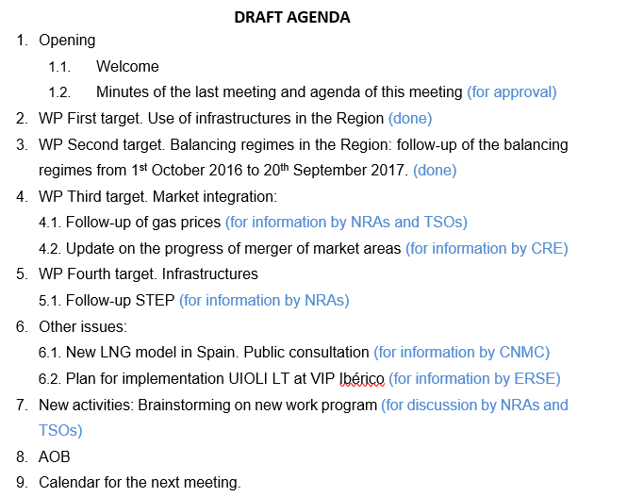
AGENDA

Slide 3
2. WP First target: use of infrastructures
DONE

Slide 4
3. WP Second target: balancing regime in the Region
  Approved : 20th of September
  Sent for publication on ACER´s website
DONE

Slide 5
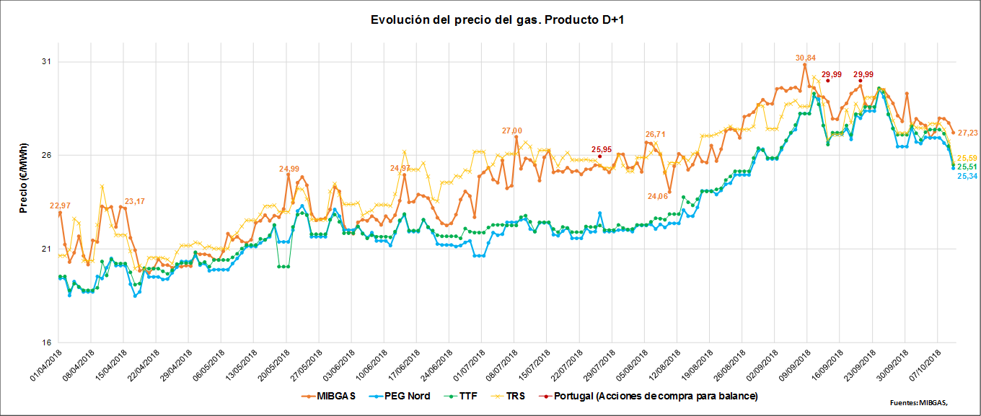
4. WP Third target: Market integration
  4.1. VIP Pirineos: gas prices and internal congestions (for information by NRAs and TSOs)
  i) Follow-up of gas prices SGRI hubs vs. neighbouring hubs
  Evolution of prices D+1 (1st April 2018- 10th October 2018)

Slide 6
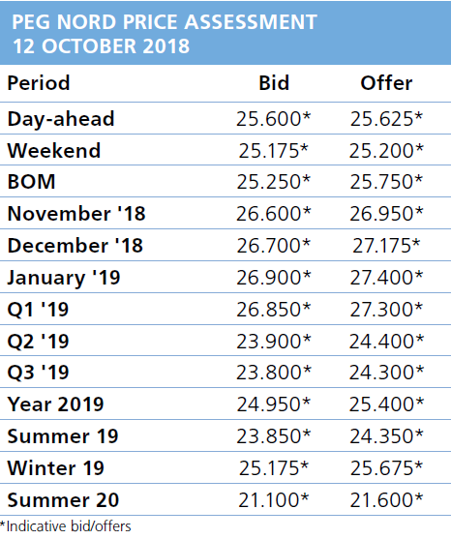
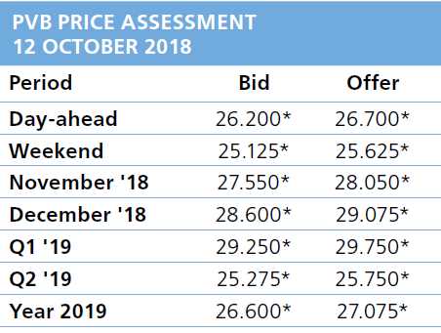
4. WP Third target: Market integration
  4.1. Winter prices (for information by NRAs and TSOs)
  i) Follow-up of gas prices SGRI hubs vs. neighbouring hubs (cont.)
  Source ICIS

Slide 7
4. WP Third target: Market integration
  4.2. Update on the creation of a single gas market area in France
  For information by CRE

Slide 8
  5.1. Follow-up STEP (for information by NRAs)
5. WP Fourth target: Infrastructures
Investment request was received by NRAs on 23th July 2018 (date from which time starts running) .
Deadline for NRAs to make a decision: 23th January 2018 (6 months).
NRAs discussion is already on process: NRAs (CRE-CNMC-ERSE) are having trilateral meetings every 2/3 weeks to define a common position.
Four CBA analysis (Pöyry, Frontier, Térega and ENAGAS-REE).
NRAs are discussing what inputs take into consideration to make their decision: Scenarios, costs, benefits, revenues, CBAs, CAPEX, OPEX, residual value, CEF funds, etc.
In conclusion, everything is currently open for discussion

Slide 9
6. Other issues
  6.1. Public consultation on new LNG terminals model in Spain

Slide 10
6. Other issues
  6.1. Public consultation on new LNG terminals model in Spain
Five potential models:
Current model + unbundled services
“Joint regasification” model (for all terminals)
“Hybrid model”
“Joint regasification and LNG storage” (virtual LNG plant)
“Unique LNG plant” model (joint management of all terminals)

Slide 11
6. Other issues
  6.1. Public consultation on new LNG terminals model in Spain
  PC launched: 28th September 2018
  Public consultation on new LNG terminals model in Spain
  Open until 31st October 2018

Slide 12
6. Other issues
  6.2. Plan for implementation of UIOLI LT mechanism at VIP Ibérico
  For information by ERSE

Slide 13
7. New activities: brainstorming on new Work Plan 2019-2020
  For discussion NRAs and TSOs

Slide 14
8. AOB

Slide 15

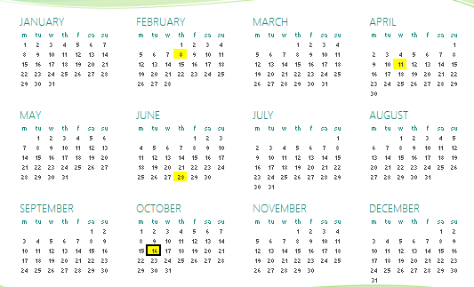
9. Calendar of the next meeting
IG
Next IG meeting: tbd (tentative date: XX November)

Slide 16
Thank you for your participation

